Slide 1
Data collection and transformation
Introductory Data Science for Innovation (995N1)
Week 3 – 11th February 2020
Frédérique Bone

Slide 2
Let’s Finish last week’s exercise.

Slide 3
Lecture objectives
Bases of data science:
This lecture will present you with an overview of data sources which are relevant for innovation studies. A few of these sources will be explored in depth in the next two lectures.
Secondly the lecture also aims to give a brief introduction of the format the data can take. How to treat these will be explored further in the seminars.
Finally, this lecture will give you a broad overview of good practice when using data collected from the web.

Slide 4
Lecture objectives
We will see:
a variety of data sources which can be used to study science and innovation
how hard/easy it is to extract data from these data sources
considerations for the use of this data (data bias)
ethical considerations for data collection and use

Slide 5
Range of data on innovation

Slide 6
Finding data – existing databases
The usual suspects:
Existing databases
Data available in through API
Data you retrieve directly from digital sources (webpages)
Notes:
There are many usual suspects for

Slide 7

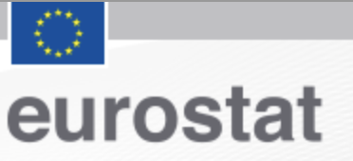







Finding data – existing databases
Existing databases
Data available in through API
Data you retrieve directly from digital sources (e.g. webpages, documents…)
The usual suspects:
You may need to pay for access, or an institutional subscription.
Notes:
Eurostat for CIS survey
OECD – variety of macro-economics statistics across countries
These may represent organisations, (companies and university), science/knowledge, which may be needed for technology, patents which represent technology, or others- such as human capital…

Slide 8
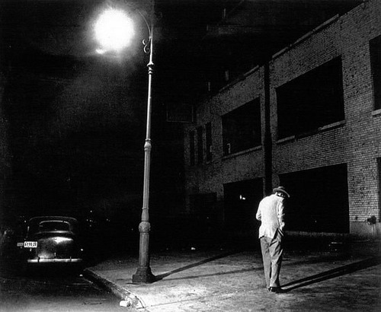
Notes:
Now it is easier than ever to build a flashlight.

Slide 9
There may be another light over there…
Notes:
Now it is easier than ever to build a flashlight.

Slide 10










Finding data – existing databases
Existing databases
Data available in through API
Data you retrieve directly from digital sources (e.g. webpages, documents…)
But other structured datasets can be used:
Notes:
There are many usual suspects for
The PhD students databases
Other EU Data
The acceptance survey (AMR)
Make the point that these organisations actually want the data to be used (make it freely available and please use it!)
Or even smaller datasets: welcome trust funding grants

Slide 11
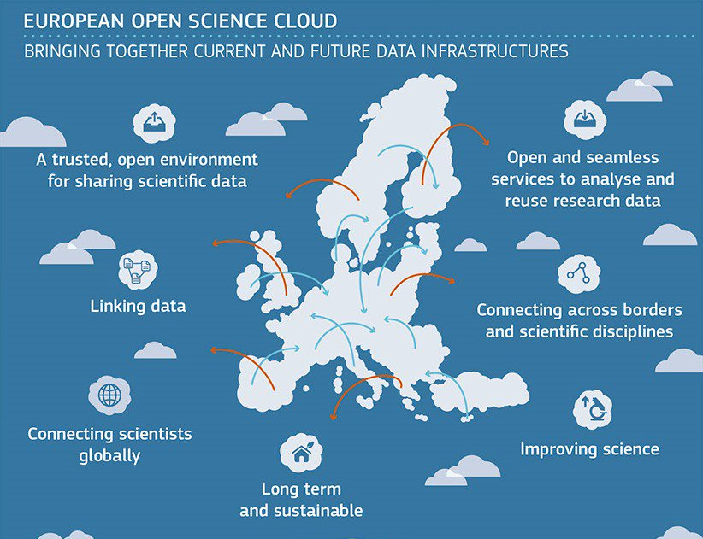
Finding data – existing databases
Existing databases
Data available in through API
Data you retrieve directly from digital sources (e.g. webpages, documents…)
But other structured datasets can be used:
Notes:
There are many usual suspects for
The PhD students databases
Other EU Data
The acceptance survey (AMR)
Make the point that these organisations actually want the data to be used (make it freely available and please use it!)
Or even smaller datasets: welcome trust funding grants

Slide 12

You can explore beyond here…
Notes:
Now it is easier than ever to build a flashlight.
There is a world to explore beyond the usual structured dataset (beyond the lamppost)

Slide 13
Finding data – through APIs
Existing databases
Data available through APIs
Data you retrieve directly from digital sources (webpages)

Slide 14
Finding data – through APIs
Available databases
Data available through APIs
Data you retrieve directly from digital sources (e.g. webpages, documents…)
API (web application - Application Programme Interface)
Ask for a subset of data to a website (in an automated way)
The request is done through the URL
<base-url> + <information about request>
The website returns a webpage with some structured text
You usually copy the content from the webpage
It is easily parsed due to its structure (XML, Json format)
You could do that directly through a browser, or even using programming tools (without opening a browser).

Slide 15









Finding data – through APIs
Available databases
Data available through APIs
Data you retrieve directly from digital sources (e.g. webpages, documents…)
Easier to access a subset of the data (some databases are very large)
Access to complementary information
Notes:
You can use these to build a primary dataset
Or you can use it to complete your data - there are more and more structured identifiers in order to be able to link the data between databases.

Slide 16
Let’s Practice!

Slide 17
Let’s start!
Load the Script of this week:
W3-Crossref-API_exercise.Rmd
We are going to explore funders of Artificial Neural Networks papers
Year / Month | Top 1 funders | # of unique funders
Jan 2020 | National Natural Science Foundation of China
Jan 2019 | National Natural Science Foundation of China
Jan 2018 | National Natural Science Foundation of China
Jan 2017 | National Natural Science Foundation of China
Jan 2016 | National Natural Science Foundation of China
Jan 2015 | National Natural Science Foundation of China
Jan 2014 | National Natural Science Foundation of China

Slide 18
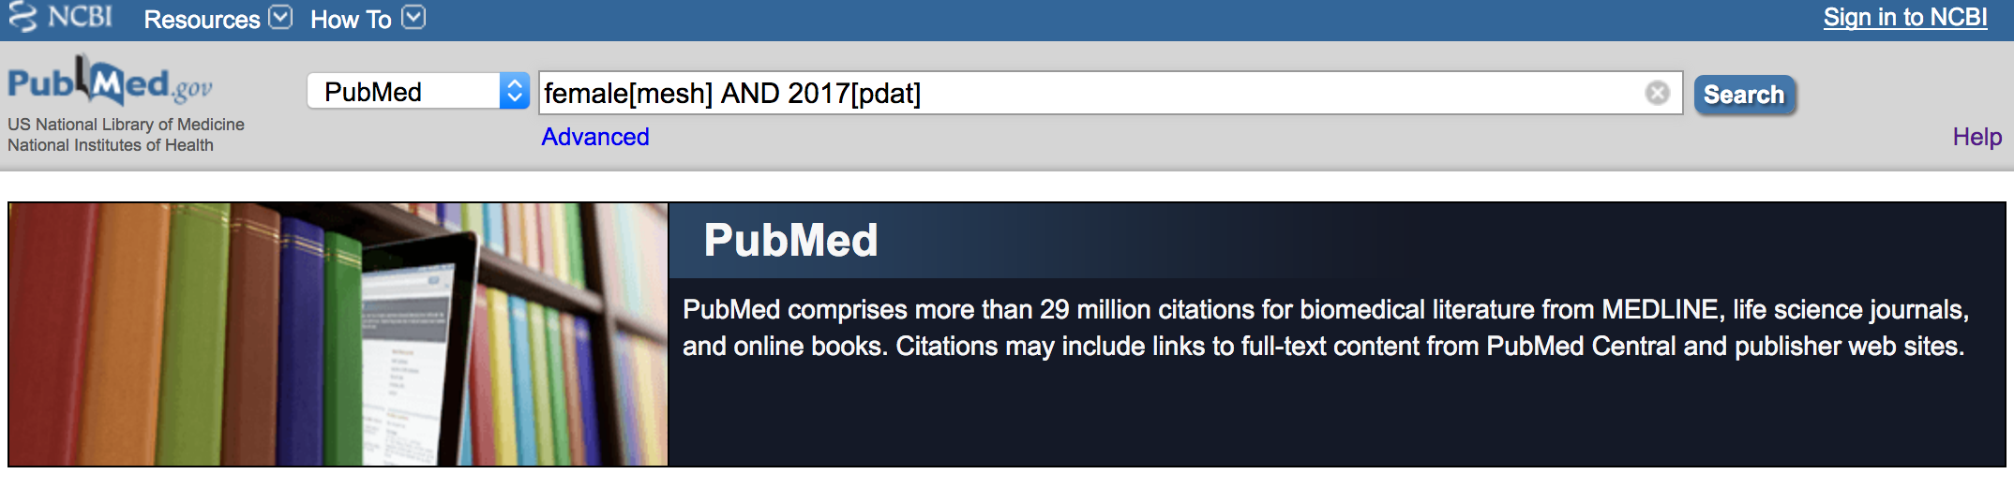
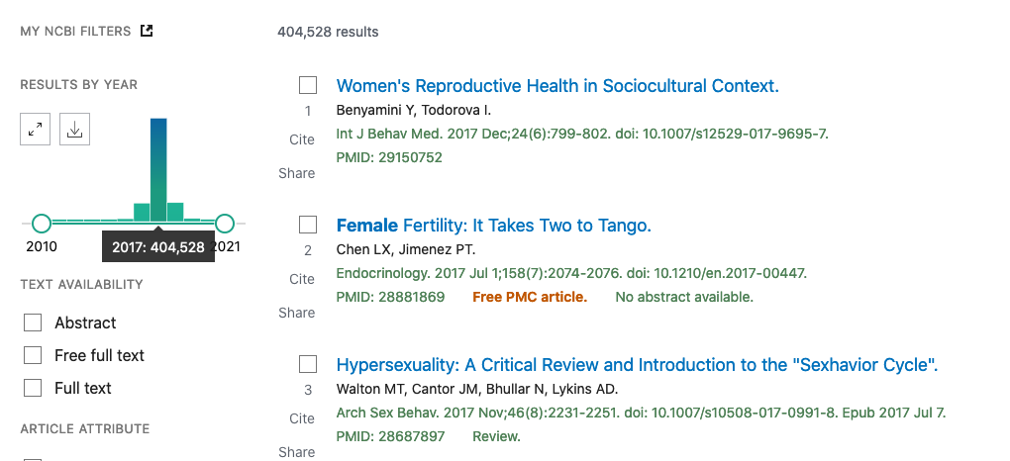
Finding data – through APIs
Available databases
Data available through APIs
Data you retrieve directly from digital sources (e.g. webpages, documents…)
Example from PubMed:
I want to find out how many publications there are when searching for a specific Meshterm “female” in the year 2017.
Notes:
https://www.ncbi.nlm.nih.gov/pubmed
female[mesh] AND 2017[pdat]
Documentation https://www.ncbi.nlm.nih.gov/books/NBK25497/

Slide 19
Finding data – through APIs
Available databases
Data available through APIs
Data you retrieve directly from digital sources (e.g. webpages, documents…)
Example from PubMed:
I want to find out how many publications there are when searching for a specific Meshterm “female” in the year 2017.
<base-url>+<information about request>
URL:
Base: https://eutils.ncbi.nlm.nih.gov/entrez/eutils/esearch.fcgi?
Database: db=pubmed
Search: term=female[mesh]+AND+2017[pdat]
https://eutils.ncbi.nlm.nih.gov/entrez/eutils/esearch.fcgi?db=pubmed&term=female[mesh]+AND+2017[pdat]
Notes:
Documentation https://www.ncbi.nlm.nih.gov/books/NBK25497/

Slide 20
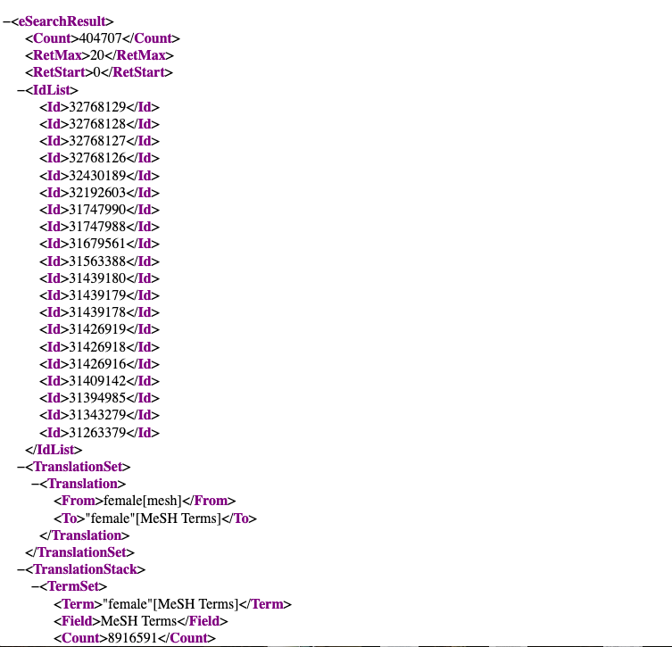

Slide 21
Finding data
Available databases
Data available through APIs
Data you retrieve directly from digital sources (e.g. webpages, documents…)

Slide 22
Finding data
Data you retrieve directly from digital sources (e.g. webpages, documents…)
Any webpage is a structured document,
and you can extract data from it.
Let’s say I want to study spin-offs from the University of Oxford:
Start by looking at the incubator website:
https://innovation.ox.ac.uk
Look for companies list
Can I export the list?
Developer tab (see the web page in a raw format)
Use of URL to iterate over the pages (use of loops)
Notes:
</h[1-3]>[[:print:][:space:]]*?<h[1-3]>
(</h1>|</h2>|</h3>|</p>)[[:space:][:print:]]*?(<h1>|<h2>|<h3>|<p[[:space:][:print:]]*?>)
Wayback machine
Structure of website – getting company names
sussex innovation center: </h2>[[:print:][:space:]]*?<h2 itemprop="name">
2) Some tools to collect the data – regex, developer tab, looking at the
more advanced techniques
webscraping techniques

Slide 23


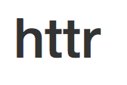
In which form will I get the data?

Slide 24
Data Format
Tables - two dimensional data:

Slide 25
Data Format
Tables - two dimensional data:
Excel spreadsheet (multiple sheets in a file)
.csv files which are usually comma delimited
but can also have other types of delimiters (tabs generally).
Proprietary formats .sav (SPSS), .dta (Stata)

Slide 26
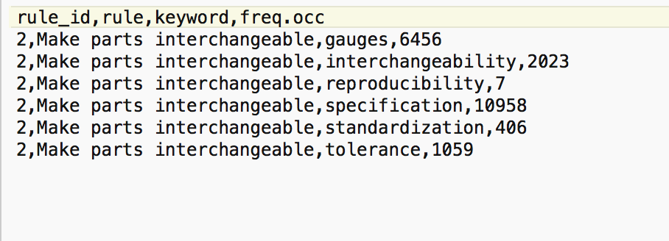
Data Format
Example of a csv file:

Slide 27
Data Format
Nested /Hierarchical data:
.json
XML files which are usually comma delimited
Data gathered through APIs are usually coming in this format.
Notes:
https://api.altmetric.com/v1/citations/1d

Slide 28
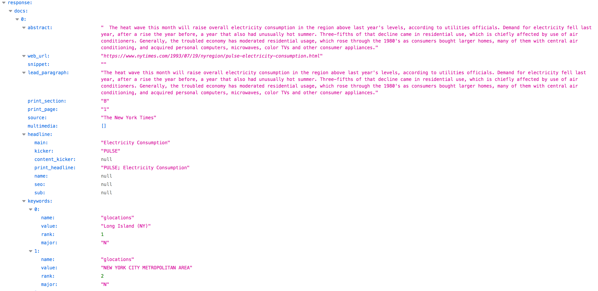
NYT API
Abstract | Web_url | … | headline |  |  | Keywords
 |  |  | main | kicker | … | name | value | rank | major
Notes:
https://api.nytimes.com/svc/search/v2/articlesearch.json?q=electricity&api-key=8o0rq1Z78Su8bbfgDwLWfDDoRnJejhXX

Slide 29
Data Format
Nested /Hierarchical data:
.json
XML files which are usually comma delimited
Data gathered through APIs are usually coming in this format.
Difficulty in dealing with lists within lists
You may need to specify how to import the data in a data frame format
Notes:
https://api.altmetric.com/v1/citations/1d

Slide 30
Data Format
Free text format (with or without metadata)
Web pages
Scanned Text
Other .txt outputs
You have to explore the underlying structure to find the best way to parse the data.

Slide 31
Let’s Practice!

Slide 32
Let’s start!
Load the Script of this week:
W3-webdata_exercise.Rmd
We are going to build a dataset from the previous website to build a incubator start-up dataset using Rvest

Slide 33
Good practice: Using data for research

Slide 34
How good is the data I get?

Slide 35
Data - quality
Every dataset has a context and history which defines its content
Different purposes
Different coverage (time / country)
The dataset may have evolved depending on user needs
Fields are introduced over time (e.g. acknowledgement /funding fields in bibliometric databases)
Some categorisation evolves over time and can create data inconsistencies (see NYT)
Notes:
Evolution may provide inconsistencies in the data, not all fields may be available for all periods.

Slide 36
Data - quality
Example from Web of Science data:
Bias of representation of languages (Chavarro, 2016)
Bias of representation of disciplines (Ciarli & Rafols 2017)
Coverage limitation for funding data (Grassano et al. 2017)
Example from the SPRU History project:
I built a database of SPRU staff to understand the scientific output over time.
Selection criteria of research staff
A colleague who wanted to re-use the data questioned its completeness.
Notes:
Garbage in – Garbage out.

Slide 37
Data - quality
Increasing cleaning needed
Existing databases
Data available through API
Data you retrieve directly from digital sources (e.g. webpages, documents…)
The more bespoke your data, the more you will need to spend time on data cleaning…
Notes:
May require quite a btit of trial and error

Slide 38
No dataset is objective.

Slide 39
No dataset is objective. They have a context and history.

Slide 40
Data - quality
Every dataset has a context and history which define its content
Different purposes
Different coverage (time / country)
The dataset may have evolved depending on user needs
→ How do I choose the right data for my analysis?
Notes:
May require quite a btit of trial and error

Slide 41
Get the right data
Research question
Start with your research question:
Object of study / phenomena
What aspects / properties are important?
Is there an existing dataset that captures these:
Is it a good representation of the phenomena
Does it cover well the aspects which are important.
How well does the data capture my research design?
Is there other data that I can use?
Is there complementary data?
Should I adapt my research question?
object of study / phenomena
Properties /aspects
Adapt research question or data?
Database / dataset
Variables
Related variables /characteristics
Missing aspects
Notes:
Garbage in – Garbage out.

Slide 42
Get the right data
Research question
object of study / phenomena
Properties /aspects
Trade-off:
Fit of the proxy to the object of study
Feasibility/time:
Searching for appropriate data
Cleaning, prepare the data for analysis
Conduct the appropriate analysis
Adapt research question or data?
Database / dataset
Variables
Related variables /characteristics
Missing aspects
Notes:
Garbage in – Garbage out.

Slide 43
Data - quality
Usual concerns about getting data for your study:
Is the database clean enough for moving to the analysis
Does it include all the variables to do my ‘fancy’ analysis
Is the database large enough for me to do a large scale/ comparative analysis
Concerns you should have when choosing data:
Is the database complete enough to generate sufficient insights for my analysis?
→ Meaning of the absence of data: non-existence vs. not captured
Is the proxy I use good enough to represent what I want to study?
Notes:
May require quite a btit of trial and error
A dataset has boundaries and is collected for a reason – the data may be extended over time because users ask for things
Presence of data (the thing that is under the light – we now that it exists and we are able to observe it)
The absence of data: (two explanations)
There is nothing there – this is why we cannot observe it
There is something there but it is just not represented in the dataset : why? How does this affect my study? Will it have a big impact on my results?

Slide 44
No dataset is bad per se,
they vary in quality and coverage.
Do they fit your research question?

Slide 45
What’s next?

Slide 46
Next lectures
The next weeks, we will deal with specific data sources:
Next week : Publication and patent data (by myself)
With a seminar practicing getting bibliometric data
Reading csv files, and use this type of data
Following week : Funding data (by ResearchFish)
With a seminar practicing on getting data from API
Further practicing cleaning datasets.

Slide 47
Thank you. Contact:
Dr Frédérique Bone
(f.bone@sussex.ac.uk)
Research Fellow at SPRU

Slide 48
Data - considerations
https://www.europarl.europa.eu/RegData/etudes/BRIE/2018/604942/IPOL_BRI(2018)604942_EN.pdf
https://www.communia-association.org/2017/12/01/uk-government-report-right-read-right-mine/
https://www.jisc.ac.uk/guides/text-and-data-mining-copyright-exception
https://assets.publishing.service.gov.uk/government/uploads/system/uploads/attachment_data/file/375954/Research.pdf
https://www.ouvrirlascience.fr/recommandations-sur-lanalyse-automatique-de-documents-acquisition-gestion-exploration/
Notes:
May require quite a btit of trial and error

